Slide 1
Fundamentals
of Programming (Week 2)
Name: Sheikh Thanbir Alam
Deg: Senior Software Programmer
Org: Army War Game Center, BD Army

Slide 2




How programming language work?
Compile
Assemble
Executing
C#
Low level Language
Machine Language

Slide 3
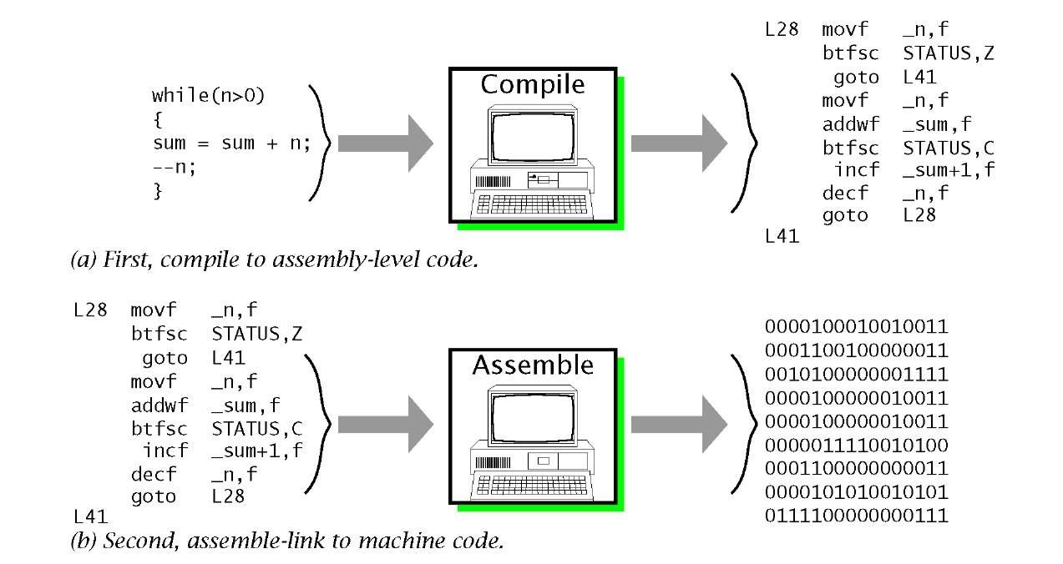

Slide 4
Let's write few programs on IDE (Basic Syntax)
Let’s Print Our Institute Name in C#.
Let’s Print Our Three Friends Name.
Let's Take Input of Our Parents Name and Print.
Let’s Take Input a Number and Print.
Let’s Take 2 Number and Print the Sum.

Slide 5
Data types.
Integer (–2,147,483,648 to 2,147,483,647)
Long (–9,223,372,036,854,775,808 to 9,223,372,036,854,775,807)
Unsigned Integer & Unsigned Long (0 to 65,535 & 0 to 4,294,967,295)
Float & Double & Long double (7 digit → 32bit & 15 digit→ 64bit & 29 digit → 128bit)
Unsigned Float & Unsigned Double
Char (8Bit)
WChar_t (16 or 32 bit)
String (2^0 to 2^31)
Boolean
Void
Custom (By User Created)
Links:
Integral numeric, Build In Types

Slide 6
Operators
Arithmetic Operators (+, -, *, /, %, ++, - -)
Relational Operators (==, !=, >, <, >=, <=)
Logical Operators (||, &&, !)
Bitwise Operators (&, |, ^)
Assignment Operators
Misc Operators
Links: More Details

Slide 7
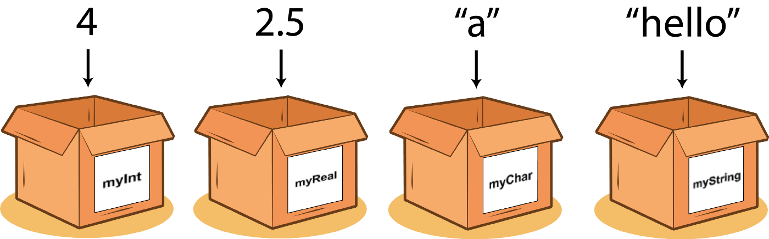
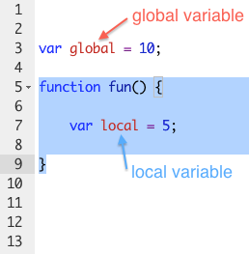
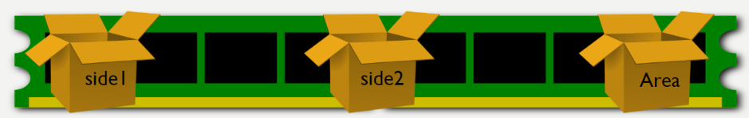
Variables

Slide 8
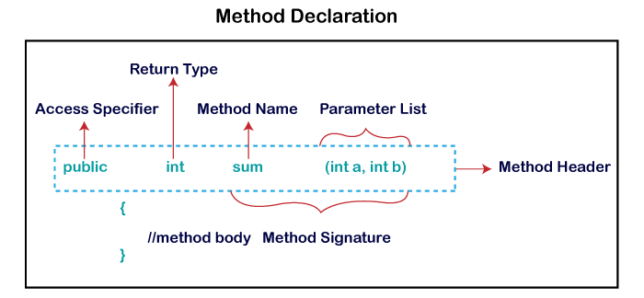
Function

Slide 9


